Slide 1
Collaboration between the Education Procurement Service(EPS) and the Local Government Management Agency(LGMA) to establish a Framework Contract for the supply of Public Library Books and Audio Visual Material (AV) to all thirty public libraries in Ireland. Susan Jones Category Manager EPS

Slide 2
Background
The Local Government Management Agency (LGMA) had a requirement for suppliers that could supply books and AV material that reflect the Irish, UK and international publishing industry including bestsellers, new titles and back catalogue.
The Educational Procurement Service, was tasked in mid 2016 with managing the procurement process for this requirement. The successful supplier would supply print books and AV material to all thirty public library services in Ireland. The total estimated value of this framework is 24 million euro.
Confidential

Slide 3
Project Aims/Team
?
The establishment of a project team was the first part of the mobilisation process of the project. Susan Jones, Category Manager (EPS) led the project from a procurement perspective and Annette Kelly, Head of Library Development (LGMA) was the operational lead. We established a core project team to represent the thirty local authority library services.
Sourcing Lead: | Susan Jones Category Manager & Gerry Kennedy Category Specialist (EPS)
Project Team: | Head Library Development LGMA
 | Executive Librarian LGMA
 | County Librarian Dun Laoghaire-Rathdown
 | County Librarian Offaly
 | City Librarian Cork City
 | County Librarian Mayo
 | Senior Librarian Dun Laoghaire-Rathdown
 | County Librarian Kildare
Confidential

Slide 4
Collaboration
This project comprised of many individuals with different experience and background. Public Sector employees generally stay in their roles for many years longer than the current governments, and many have seen initiatives come and go!
It was critical to the success of the project that the benefits were understood by the stakeholders and that concerns were addressed and managed.
At our first face to face meeting, in order to ensure that we worked collaboratively and with clear objectives a Force Field analysis was completed. We driving and restraining forces relating to this project and we assigned a value to each of them.

Slide 5
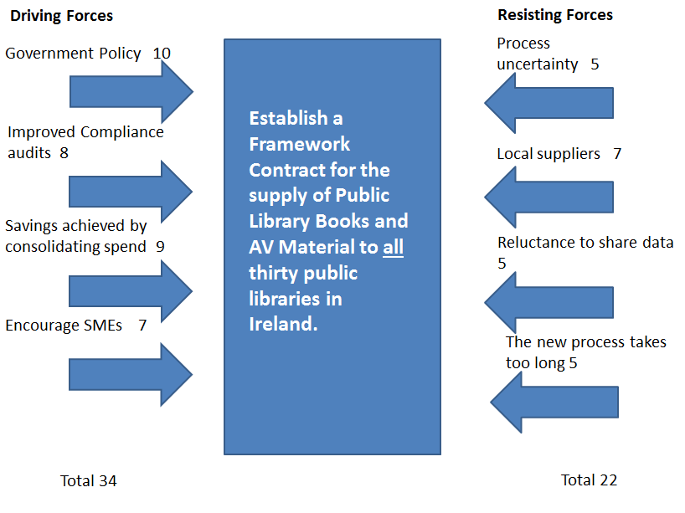
Force Field Analysis
Notes:
In order for the change to occur the driving forces must be higher than the resisting forces and in this case they are, so change is possible and the project could proceed. This analysis was communicated at our initiation meeting where the need for the change and the benefits to the stakeholders were outlined clearly. In addition, it was highlighted to all on the project the role they had to play in order to successfully implement the project. Concerns were taken on-board and discussed in detail and documented and managed.

Slide 6
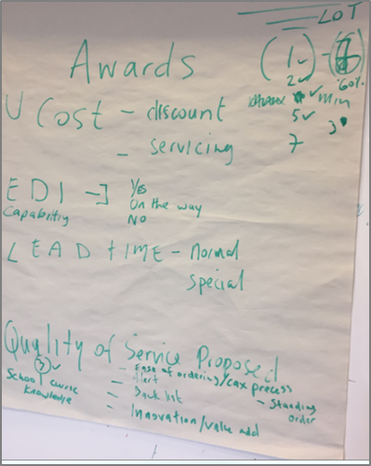
Brainstorming
?
Questions
Confidential
Notes:
Following on from the initial meeting, the Core Project team participated in a brain storming session. We reviewed EU Procurement Guidelines, historical RFTs, spend analysis and future requirements.
This enabled the team to understand the context and get into more detail regarding the consolidated approach. The session was organised for one and a half hours. Ideas were placed on post-its. The next sixty minutes was a review and discussion of the ideas generated.
The outputs of the Brain Storming session first draft of the award criteria that the team agreed upon.

Slide 7
Small Medium Enterprise
?
It was agreed by the EPS and the LGMA that we would engage with the supply base together. There were two Buyer/Customer/Supplier meetings before the finalisation of the tender strategy
Capacity and turnover requirements were relevant and proportionate, which broadened the field of eligible tenderers.
Questions
The lot structure proposed (6 LOTS), by category, corresponded to the existing supply structure without compromising efficiency and value for money.
Confidential
Notes:
The turnover requirement of €100,000 which is less that the estimated contract value rather than a multiple of the contract value was incorporated into the tender.

Slide 8
Execution
The Tender strategy balanced the need of the LGMA with the supplier market, with specific consideration of the impact on Small and Medium Enterprises (SMEs). For this competition, the overall requirement was split by category (6 lots), based on the way that the market organises itself and its own marketing and selling activities.
These lots and estimated annual values were (1) Adult Fiction– value €1million, (2) Adult Non Fiction – value €1.5million (3) Junior Fiction & Non Fiction – value €1.7m, (4) Irish Published Books– value €600,000, (5) Trade Paperbacks– value €500,000 and (6) DVDs, Music CDs and Console Computer games– value €700,000. Total estimated value of the project over four years is €24 million. Proposals would be evaluated for quality (55%) and cost (45%).

Slide 9
Snap Shot
Request for EPS support June 2016
RFT Posted on E-Tenders 21st October 2016
28
Tenders submissions
Parliamentary
Questions
20 plus
10 Evaluation Team
Members
2 – Clarifications raised during standstill
1 – Legal challenge
Projected savings
5% of value of contract
4
Suppliers were identified as having MEAT.
Term
One year with option of three extensions
6
LOTS
Contracts signed January 2017
20 plus supplier questions answered during tender process
Confidential

Slide 10
Challenges
?
On the 17th of January 2017, one of the unsuccessful suppliers through their solicitors issued formal challenge to the result of the tender. The main focus of the challenge related to one of the technical award criteria - EDI capability. The supplier contended that they should have been awarded full marks stating they had full EDI capability. This was disputed by the EPS and the LGMA. 150 marks for EDI Capability were available to tenderers who responded that the tenderer had the Acquisitions API currently available.
Quick Click ordering which was referenced in supplier’s tender response was not the Innovative Interfaces Acquisitions API as defined in the Request for Tender and was scored appropriately. The EPS/LGMA worked closely together to ensure that the legal team had all of the information required to support the tender result. The foundation of a collaborative relationship developed early in the process and was paying dividends during this challenging time. After four months the EPS and the LGMA were informed that the supplier was withdrawing their challenge.
Questions
Confidential

Slide 11
Outcome & Results
Estimated savings of 1.2million over the contract term (Four Years)
Standardising the approach will achieve better value for money by
The reduction of administration
Clearly defined requirements and specifications signed off by all Public Libraries
Moving from a fragmented model, with multiple supplies, specifications and processes
Effective management of risk
Questions
Compliance to public procurement guidelines and ensuring adherence to new directives
Data – access to spend data, trends and supplier information
Brought about a new way of working , this template will be used for future procurement projects
Confidential
Notes:
Procurement professionals manage the procurement process and that leaves librarians able to get on with their jobs!

Slide 12
?
YOU CAN’T SPELL
CHALLENGE
WITHOUT
CHANGE.
IF YOUR GOING TO RISE TO THE CHALLENGE, YOU HAVE TO BE PREPARED TO CHANGE AND PARTICIPATE .
Questions
Thank you
Confidential

Slide 13
?
Back up
Put in Award Criteria
Questions
Confidential

