Slide 1
Customer Services Excellence (CSE) workshop
Cork University Library, Cork, 29 March 2017
Dr Graham Walton, Honorary Research Fellow, Centre for Information Management, Loughborough University and Customer Services Excellence Assessor

Slide 2
Experience as an Assessor for Customer Services Excellence Customer Services Excellence Assessor since 2015 Assesses over 20 different organisations in UK Range from the large (DVLA) to the small (housing association) CSE assessor for 4 university libraries Overseeing introduction of CSE across all services in one UK university
Experience in academic libraries
Worked for 35 years across Northumbria and Loughborough Universities’ Libraries Assistant Director where introduced CSE in 2008 and oversaw it for 7 years Honorary Research Fellow, Centre for Information Management 2014 -. Editor of New Review of Academic Librarianship, 2008 -

Slide 3
Worshop1: Different views about ‘customer’ in higher education The President of your University/ College has decided that students are now to be called customers. This will take place within the next 6 months and is now open for consultation. You have been asked to provide the Library response. Groups to look at arguments either about whether it is a good idea or a bad idea

Slide 4
CSE: where it is based

Slide 5
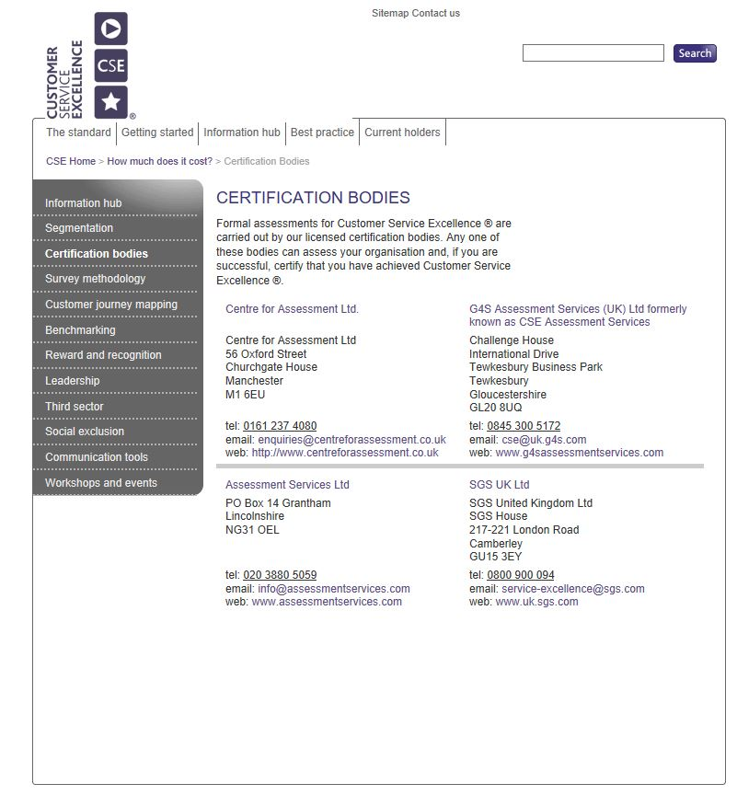
CSE Certification bodies

Slide 6
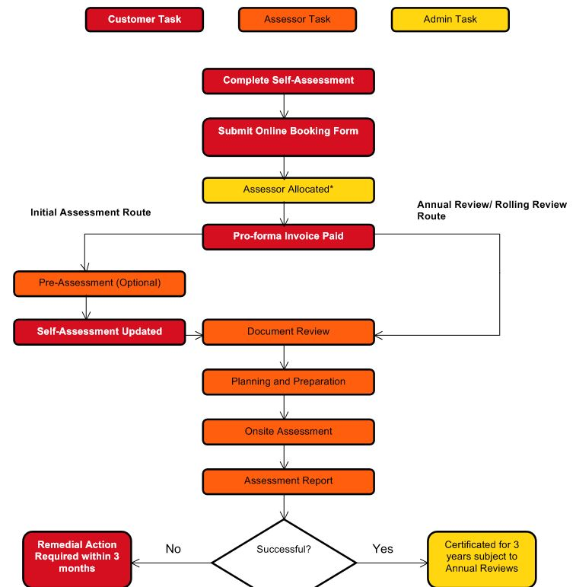
Flow chart showing CSE journey
Notes:
.

Slide 7
Stages to go through for Customer Services Excellence
Self assessment
Pre assessment visit
Preparing the evidence
Documentary analysis
On-site assessment
Receiving recommendation and report
Annual Review Year 1 and 2

Slide 8
What is Customer Service Excellence?
Delivery
Timeliness
Information
Professionalism
Staff Attitude

Slide 9
Five Themes
Customer Insight
Culture
Information and Access
Delivery
Timeliness and Quality

Slide 10
1. Customer Insight
Customer Identification
Engagement and Consultation
Customer Satisfaction
Notes:
Customer Insight is about
Identifying who our customers are
Knowing what their needs are
Looking at how we reach them
What methodologies do we use for developing our understanding of them
What strategies do we have for engaging and consulting them
Do we regularly review of our methods and approaches
Setting of challenging targets for improvement
Evidence of positive changes made as a result of analysing customer experience

Slide 11
2. Culture of the Organisation
Leadership
Policy and Culture
Staff Professionalism and Attitude
Notes:
Organisational culture can most easily be described as “the way things are around here”. It is a mix of everything about the workplace that makes it what it is, from the way people speak to each other to the work expectations to the way work tasks are organised.
In this area we show our
Corporate commitment to the customer
Policies and procedures that tell customers what they can expect
Evidence that all customers are treated fairly
Feedback from staff is invited and used to make improvements
Staff are polite and friendly
Link with appraisal process, training and recruitment

Slide 12
3. Information and Access
Range of Information
Quality of Information
Access
Collaborative working
Notes:
Provision of information about our services is about looking at our
Communication channels
Whether the Information we provide is accurate
Study environment
Partner institutions, consistency and coordination
Accountability
Collaborative working with other providers, partners and communities

Slide 13
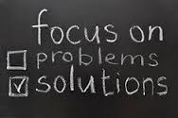
4. Delivery
Delivery standards
Achieved outcomes
Solution focused
Notes:
Standards, KPIs and benchmarking
How we monitor and tell customers
Consultation with customers, partners and staff
Feedback on service delivery
Learned from best practice and published
Complaints procedure and published actions
Solution focused approach to solving problems

Slide 14
5. Timeliness and quality of Service
Standards for timeliness and quality
Timely outcomes
Achieved timely delivery
Notes:
Measurable standards for customer contact
Standards for all aspects of CS
First point of contact service levels and referrals
Response times
Monitoring of performance against standards
Benchmarking with other institutions

Slide 15
Compliance levels
Compliance Plus – Your organisation can demonstrate behaviours or practices that exceed the requirements of the standard
Compliant - Your organisation has a variety of good quality evidence that demonstrates that you comply fully with this element.
Partial Compliance – Your organisation has some evidence but there are gaps
Non- Compliant - Your organisation has little or no evidence of compliance.

Slide 16
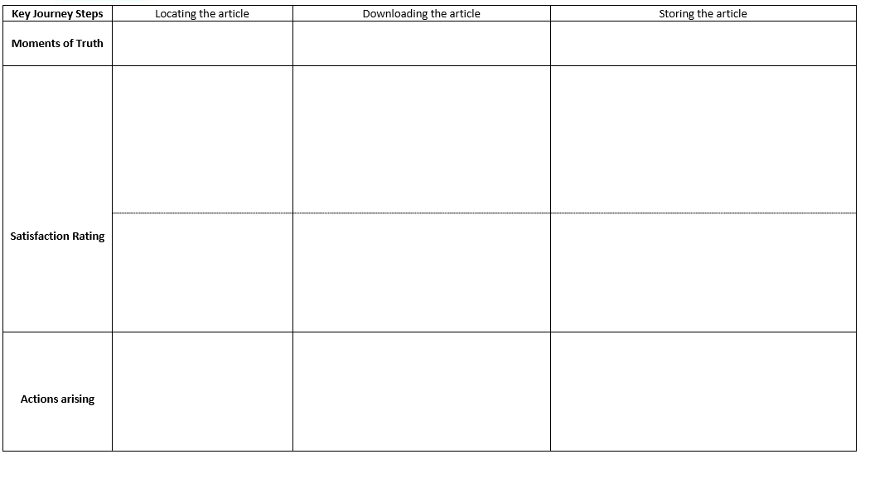
Customer journey mapping exercise

Slide 17
External quality frameworks for academic libraries: CSE vs LibQual Providing structure Generic vs library specific Geographical coverage Costs and workload Evidence Implications for managing framework

Slide 18
Q & A about customer services excellence: one hat as librarian and one hat as assessor

Slide 19
Workshop 2: evidence and the library customer experience
Group 1 (Criterion 1): What do different library customers want from the library? Identify between 3 and 5 different types of library user and the different things they want from the library.
Group 2 (Criterion 2): What do library staff need to do to provide a good customer focussed library service?
Group 3 (Criterion 3): How do you provide good customer focussed information about your library service to customers?

Slide 20
Workshop 2: evidence and the library customer experience
Group 4 (Criterion 4): What are the Key Performance Indicators to show that you are providing a good library customer experience?
Group 5 (Criterion 5) : What will show that your users of your digital library are having a good customer experience?

Slide 21
Workshop 3: benefits of Customer Service Excellence for the library In your groups, identify 3 benefits that your library could gain from CSE

Slide 22
Workshop 4: What are the barriers to achieving customer services excellence? Identify reasons and add to the fishbone

Slide 23
Workshop 4: What are the barriers to achieving customer services excellence? Take your colleagues’ flip chart and record the solutions to the barrier

Slide 24
General discussion about Irish university/ college libraries and Customer Services Excellence Your thoughts?

